Slide 1
Plugins
by
Daniel

Slide 2
On the wake of
Cheet-Sheets
Still lazy
Still a wnnabe-dev
Still works
Still good feedback

Slide 3
Which ones
MySQL for VS Code
Page Ruler for Chrome
JSON Parser for Chrome
Eye Dropper for Chrome

Slide 4
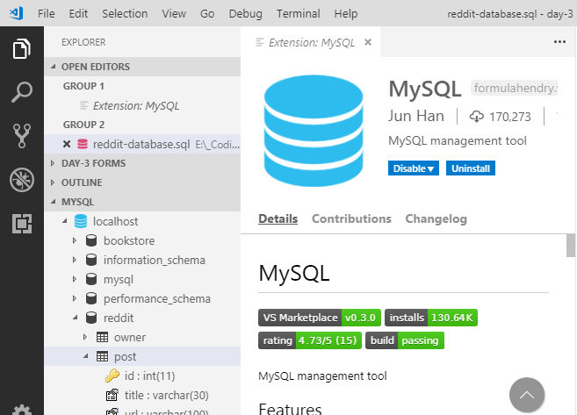
MySQL for VSCode

Slide 5
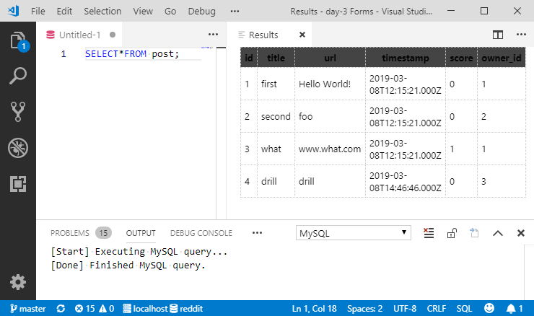
MySQL for VSCode

Slide 6
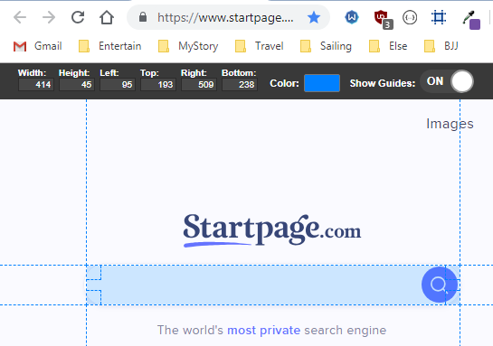
PageRuler for Chrome

Slide 7
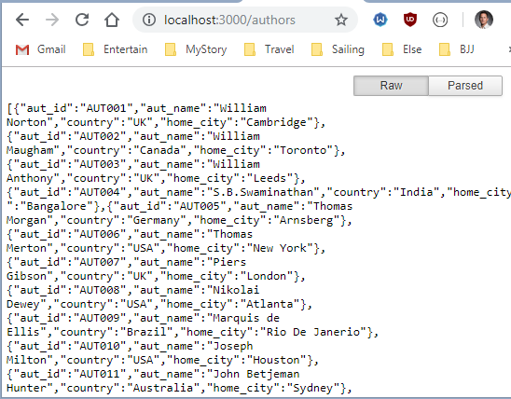
JSON Parser for Chrome

Slide 8
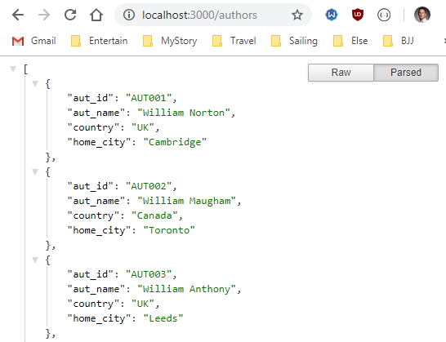
JSON Parser for Chrome

Slide 9
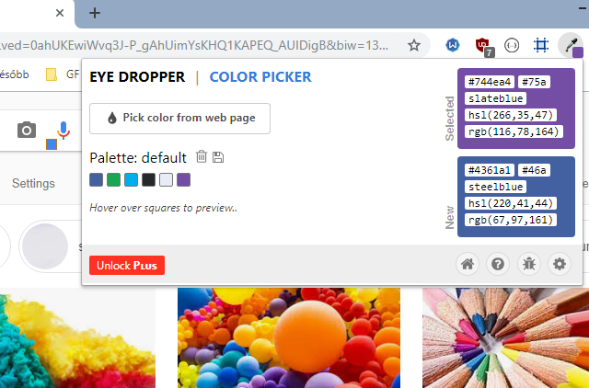
EyeDropper for Chrome

